Slide 1
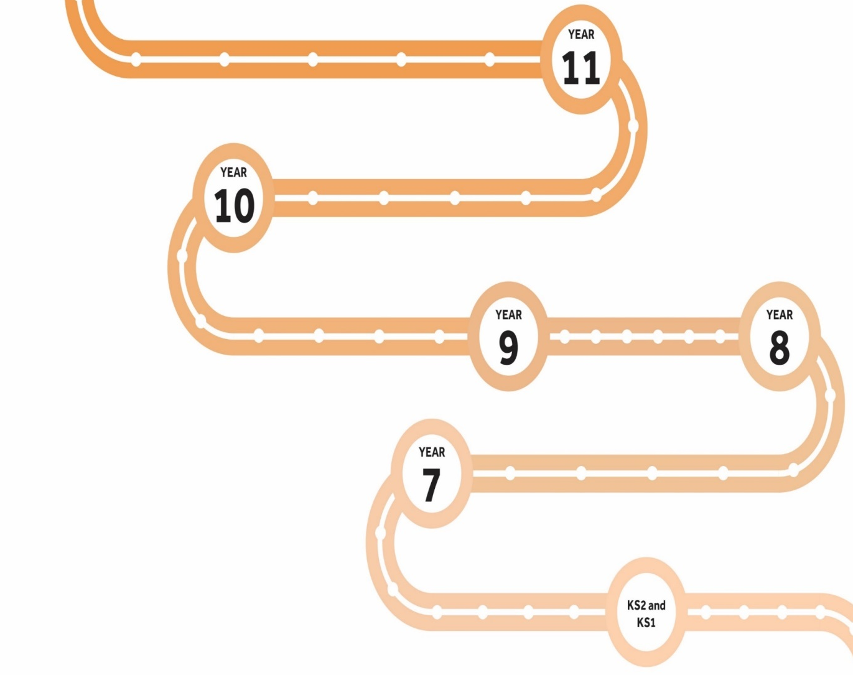
Millom School Learning Journey
GCSEs
Next Slide
Discuss future options with INSPIRA
Coach a group of younger students
Complete DofE bronze
Start KS 4 curriculum
Take part in work experience
Sit end of Year 10 exams
Develop revision skills
The Millom Learner
Determined
Communicator
Positive
Understanding
Independent
Collaborator
Investigator
Energetics and materials
Skills – Make predictions and test them through investigations
Careers – biochemist, pharmacist.
Get involved in STEM
Elements, mixtures and compounds
Make options choice for Triple Science or Trilogy
Careers – Healthcare analyst
Chemical Reactions
Earth Science
Skills – be able to write formula equations for simple reactions
Careers – chemical engineer.
Be able to safely carry out simple chemical practical's
Acids and Alkalis
Substances and Particles
Possible careers – lab technician, forensic scientist
Be able to write word equations for simple chemical reations
Attend Year 5 and 6 Open evening
Attend Year 5 and 6 Day
KS2-3 Transition

