Slide 1
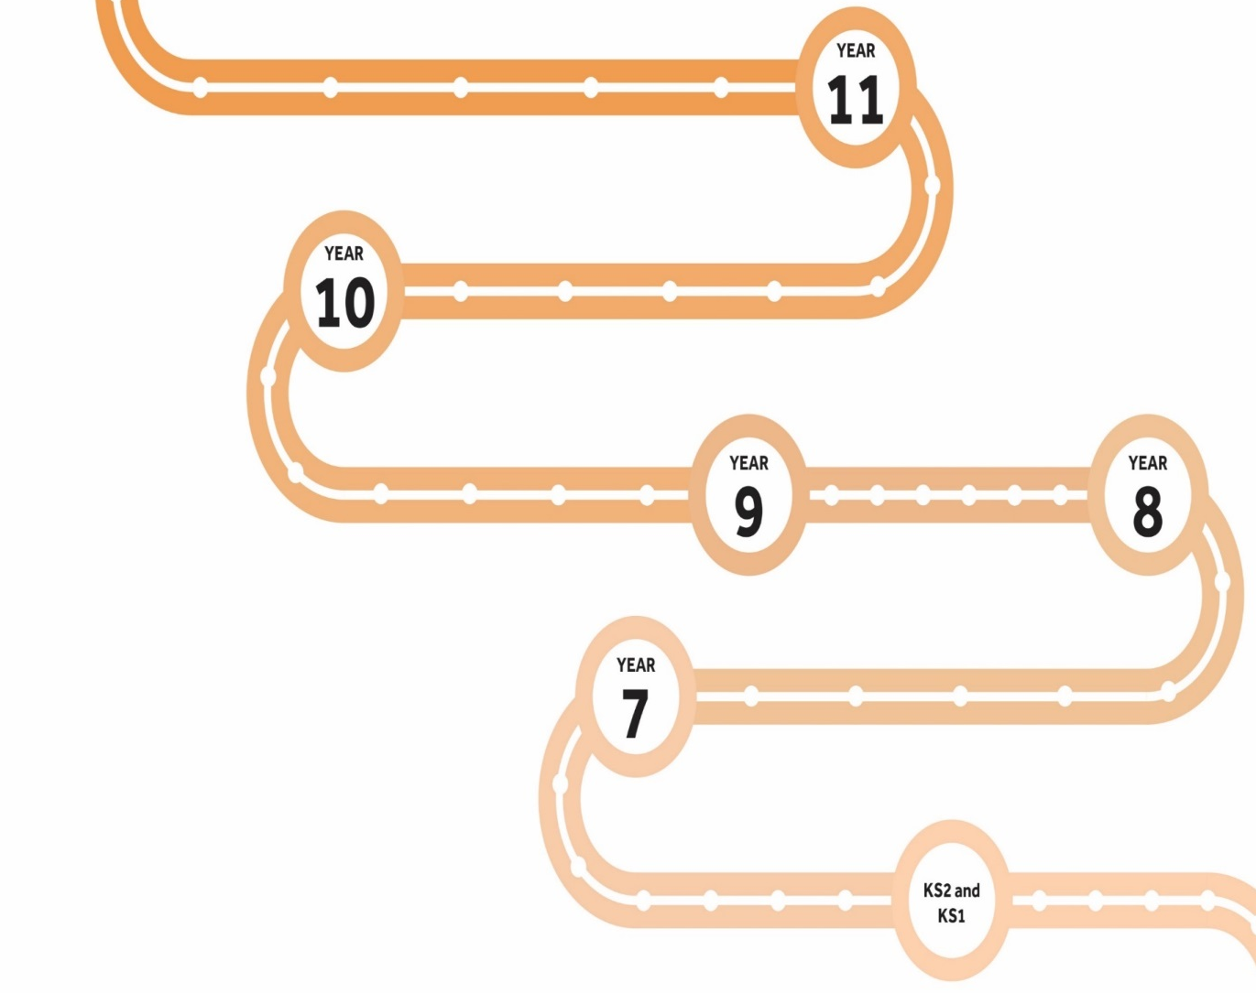
Millom School Learning Journey
GCSEs
Next Slide
Discuss future options with INSPIRA
Coach a group of younger students
Complete DofE bronze
Take part in work experience
Sit end of Year 10 exams
Develop revision skills
The Millom Learner
Determined
Communicator
Positive
Understanding
Independent
Collaborator
Investigator
Start KS 4 curriculum
Careers – dietician, personal trainer, beautician
Get involved in STEM
Skeleton and Digestion
Inheritance
Skills – analyse data and draw conclusions
Careers – Agronomist, nursing
Photosynthesis and Respiration
Health and Breathing
Skills – importance of health eating. Maths skills balance calorific intake
Career pathways – farmer, ecologist, soil scientist, conservationist.
Make options choice for Triple Science or Trilogy
Math skills learning to calculate Magnification and safe use of laboratory equipment
Ecosystems
Cells and Reproduction
Possible careers – lab technician, vet, doctor, immunologist
Math skills – graphical interpretation. Gain an understanding of interdependence
Attend Year 5 and 6 Open evening
Attend Year 5 and 6 Day
KS2-3 Transition

